Slide 1
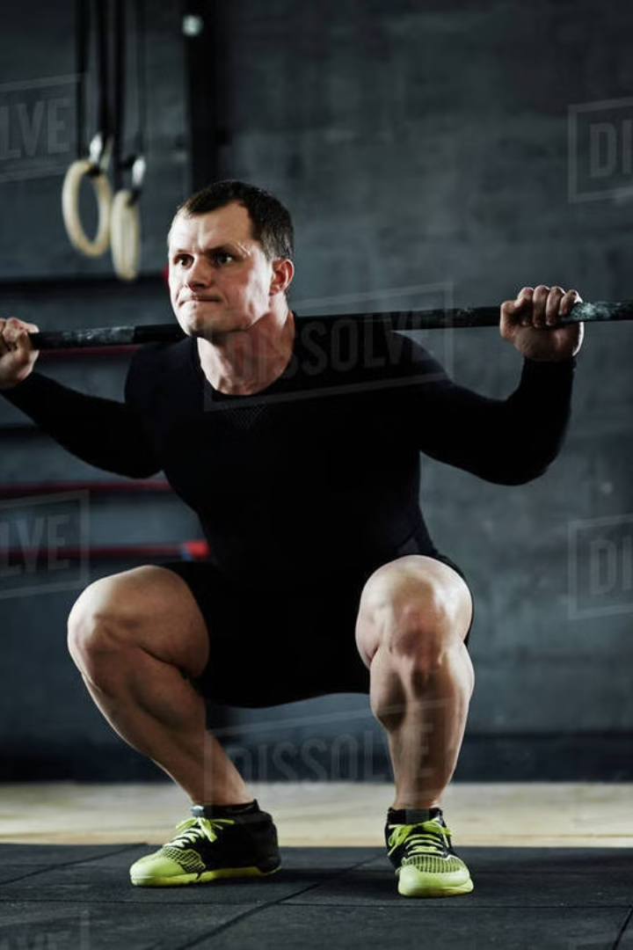
UNLEASH YOUR STRENGTH
Welcome to "Unleash Your Strength", your premier online destination for all your gym and fitness needs. This platform will empower you to explore a vast selection of high-quality products, streamline your shopping experience, and unlock your full potential.
PRESENTER :
R. VIJAY KUMAR & R. VISHVAJIT (A21CSDC52 & A21CSDC53)
UNDER THE GUIDANCE OF Mr. P. Simon Vasantha Rooban, M.C.A.,M.Phil

Slide 2

ABOUT THE PROJECT
Comprehensive Product Catalog
Seamless Shopping Experience
Empowering Your Fitness
Browse through our extensive collection of gym equipment, supplements, apparel, and accessories to find the perfect items to support your fitness journey.
Enjoy a user-friendly interface, secure checkout process, and convenient shipping options to make your purchasing experience hassle-free.
Our mission is to provide the tools and resources you need to achieve your fitness goals and unleash your full strength potential.

Slide 3

HOME PAGE
Intuitive Navigation
Featured Products
Fitness Tips Goals
The home page features a clean, responsive design with intuitive navigation, allowing you to easily explore our product categories.
Discover our top-selling and most popular gym products, highlighted to inspire and guide your shopping experience.
Gain valuable insights and training tips from our fitness experts to maximize the effectiveness of your workouts and lifestyle.

Slide 4
PRODUCT CATALOG
1
Diverse Product Categories
2
Detailed Product Information
Browse our comprehensive catalog, featuring equipment, supplements, apparel, and accessories for all your fitness needs.
Explore in-depth product descriptions, specifications, and customer reviews to make informed purchasing decisions.
3
Flexible Filtering Options
4
Personalized Recommendations
Easily narrow down your search using advanced filters, such as brand, price range, and product type.
Receive tailored product suggestions based on your browsing history and fitness goals.

Slide 5
DEDICATED MODULES
1
PRODUCT BUYING PAGE
2
TESTIMONAL PAGE
The entry point of the website, providing an overview of available products and navigation options.
A platform for customers to share their experiences and feedback about the purchased products or overall shopping experience
3
ABOUT US
4
CONTACT US
A page offering information about the company behind the online store, its mission, values, and team
A channel for customers to communicate with the company for inquiries, support, or feedback.

Slide 6




ORDER TODAY
Add to Cart
Select the desired products and add them to your shopping cart with just a few clicks.
Fast Delivery
Our lightning-fast delivery service: where speed meets satisfaction, right at your doorstep!
Easy Shopping
Seamlessly complete your purchase through our secure and encrypted checkout process.

Slide 7




SHOPPING EXPERIENCE
Personalized Experience
Save for today
Rich products
Customization
Easily access and revisit the products you've saved for future consideration.
Track the status of your orders and receive updates on shipping and delivery.
Tailor your preferences and settings to enhance your overall shopping experience.
Manage your account details, including personal information and order history.

Slide 8

FUTURE ENHACEMENTS
PRODUCTS
RECOMMENDATION
VIRTUAL REALITY
SOCIAL FEATURES
Implement a recommendation system that suggests products based on users' browsing history, purchase behavior, and preferences.
Introduce a virtual try-on feature for apparel and accessories, leveraging augmented reality (AR) technology
Integrate social features such as user profiles, forums, and social media sharing to foster a sense of community among fitness enthusiasts.

Slide 9
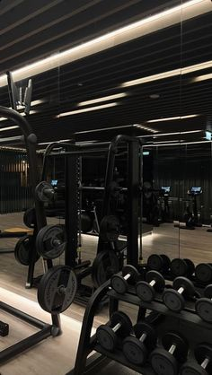
Fitness Tips for Success
HYDRATION
STRENGTH
MUSCLE REPAIR
"Stay hydrated throughout the day to optimize your workout performance and recovery."
"Incorporate strength training into your routine to build lean muscle mass and boost metabolism."
"Prioritize quality sleep to support muscle repair and overall well-being."

Slide 10
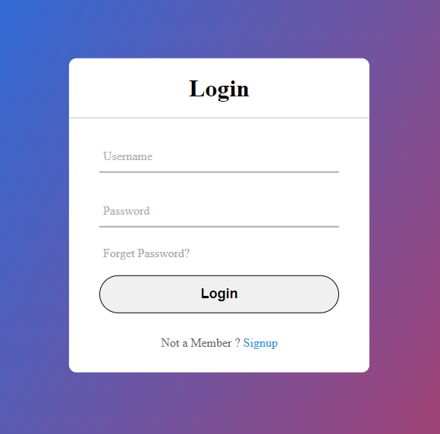
LOGIN MODULE
Admin
Responsible for managing the backend operations and overseeing the platform's functionality.
Customers
Users who intend to browse and purchase gym products from the platform
Staff Support
Individuals designated to provide assistance and support to customers regarding their inquiries or issues

Slide 11

Revolutionary access to gym products
PREMIUM SELECTION
Shopping Experience
JOIN THE MOVEMENT
Discover high-quality gym products tailored to your fitness goals.
Enjoy a user-friendly interface with detailed product information and customer reviews.
Be part of our fitness community and unlock your physical potential.

Slide 12

PREMIUM PRODUCTS DIRECTLY TO YOU
TOP-NOTCH QUALITY
HASSLE FREE DELIVERY
CONFIDENCDE PURCHACE
Receive premium gym products sourced from reputable brands.
Enjoy prompt and reliable shipping services for a stress-free shopping experience.
Trust in the quality and durability of our gym products for long-term use.

Slide 13

CONCLUSION
At "Unleash Your Strength," we are committed to empowering you on your fitness journey. Explore our comprehensive online platform, discover the best gym products, and unlock your true strength potential. Let's work together to achieve your goals and transform your fitness aspirations into reality.

